Slide 1
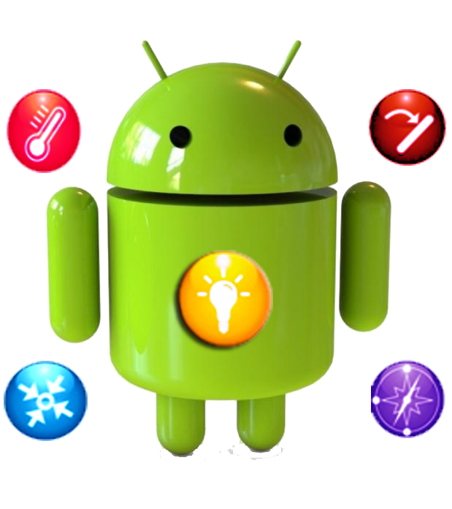
Mobile Sensors support in android platform
Ahmed Ashraf Hamza
Ahmed Osama Gomaa

Slide 2
Outline
What is sensor?
Sensors in Mobile Devices.
Types of Sensors.
Android sensor framework.
Some Classes in these Frameworks.
Motion Sensors.
Position Sensors.
Types of Position sensors.
Environment Sensors.
Common types of Environment sensors.
Summary.

Slide 3
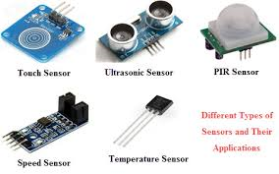
What is the sensor?
Sensor is a device, module, or subsystem whose purpose is to detect events or changes in its environment and send the information to other electronics.

Slide 4
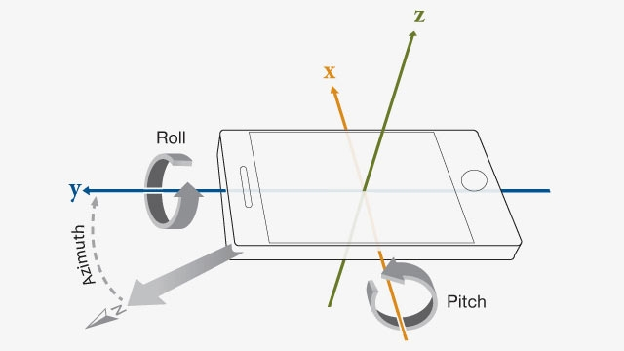
Sensors in Mobile Devices
These sensors can provide raw data with high precision and accuracy, and are useful if you want to monitor three-dimensional device movement or positioning, or you want to monitor changes in the ambient environment near a device.

Slide 5
Types of Sensors
Hardware-based | Software-based
Physical components built into a handset or tablet device | Not physical devices, although are near hardware-based sensors
They derive their data by directly measuring specific environmental properties | Derive their data from one or more of the hardware-based sensors and are sometimes called virtual sensors or synthetic sensors.
Acceleration, Geomagnetic field strength, or Angular change | The gravity sensor
Notes:
Most Android-powered devices have an accelerometer, and many now include a gyroscope. The availability of the software-based sensors is more variable because they often rely on one or more hardware sensors to derive their data. Depending on the device, these software-based sensors can derive their data either from the accelerometer and magnetometer or from the gyroscope

Slide 6
Android sensor framework
The Android sensor framework provides several methods that make it easy for you to determine at runtime which sensors are on a device.
The API also provides methods that let you determine the capabilities of each sensor, such as its maximum range, its resolution, and its power requirements.

Slide 7
Some Classes in these Frameworks
Sensor Manager:
You can use this class to create an instance of the sensor service. This class provides various methods for accessing and listing sensors, registering and unregistering sensor event listeners, and acquiring orientation information.
b)Sensor:
This class provides various methods that let you determine a sensor's capabilities.
c)Sensor Event:
The system uses this class to create a sensor event object, which provides information about a sensor event. A sensor event object includes the following information: the raw sensor data, the type of sensor that generated the event, the accuracy of the data, and the timestamp for the event.
d)Sensor Event Listener:
You can use this interface to create two callback methods that receive notifications (sensor events) when sensor values change or when sensor accuracy changes.

Slide 8
Sensors Availability
While sensor availability varies from device to device, it can also vary between Android versions. This is because the Android sensors have been introduced over the course of several platform releases.
For example, many sensors were introduced in Android 1.5 (API Level 3), but some were not implemented and were not available for use until Android 2.3 (API Level 9).

Slide 9
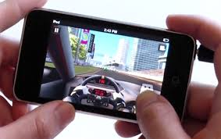
1-Motion Sensors
Motion sensors are useful for monitoring device movement, such as tilt, shake, rotation, or swing.
Motion sensors by themselves are not typically used to monitor device position, but they can be used with other sensors.
Different Cases:
First Case: a user is steering a car in a game or a user is controlling a ball in a game (In this case: you are monitoring motion relative to the device's frame of reference or your application's frame of reference)
Second Case: moving with you while you drive your car(in this case: you are monitoring motion relative to the world's frame of reference)

Slide 10
Motion Sensors
Return type of these Sensors
All the motion sensors return multi-dimensional arrays of sensor values for each Sensor Event.
Most Used Motion Sensors
The rotation vector sensor and the gravity sensor are the most frequently used sensors for motion detection and monitoring.
The rotational vector sensor is particularly versatile and can be used for a wide range of motion-related tasks, such as detecting gestures, monitoring angular change, and monitoring relative orientation changes.

Slide 11
Some Sensors
Sensors | Desc.
Gravity sensor | Used to determine the device's relative orientation in space
Linear accelerometer | Representing acceleration along each device axis, excluding gravity.
Rotation vector sensor | Represents the orientation of the device as a combination of an angle and an axis
Significant motion | Motion that might lead to a change in the user's location; for example walking, biking, or sitting in a moving car.

Slide 12
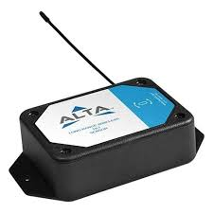
2-Position Sensors
Useful for determining device's physical position.
The geomagnetic field and accelerometer sensors return a multi-dimensional array of sensor values for each “SensorEvent”.
Hardware-based sensors.
Position sensors that are supported on the Android platform: A) “TYPE_GAME_ROTATION_VECTOR”.
B) “TYPE_MAGNETIC_FIELD”.
C) “TYPE_GEOMAGNETIC_ROTATION_VECTOR”.
D) “TYPE_ORIENTATION” (was deprecated in Android 2.2(API level 8)).
E) “TYPE_PROXIMITY”.

Slide 13
Types:
Sensor | Description | Examples | Pros
Geomagnetic field sensor | Measures earth's magnetic field Strength (in micro-tesla unit) along 3D coordinator. | BMM150(low power and low noise for compass apps).
Accelerometers sensor | Are integrated circuits or modules used to measure the acceleration of an object to which they are attached. | Vehicle dynamics, image stability, tap detection and anti-theft devices. | In mobile monitoring could be used to monitor older people who live alone.
Proximity sensor | How close the face of device to an object. | Anti-aircraft warfare and Parking sensors. | Can have a high reliability and long functional life because of the absence of mechanical parts and lack of physical contact between the sensor and the sensed object.

Slide 14
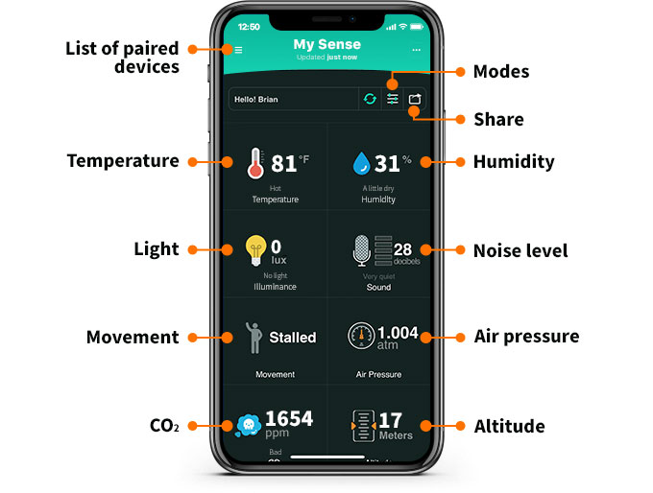
3-Environment Sensors
Provides sensors that let you monitor various environmental properties which we can use it to monitor humidity , pressure and temperature near an Android device.
Hardware-based sensors.
Unlike most motion sensors and position sensors, which return a multi-dimensional array of sensor values for each “SensorEvent”, environment sensors return a single sensor value for each data event.
Environment sensors that are supported on the Android platform:
A) “TYPE_AMBIENT_TEMPERATURE”.
B) “TYPE_LIGHT”.
C) “TYPE_PRESSURE”.
D) “TYPE_RELATIVE_HUMIDITY”.
E) “TYPE_TEMPERATURE”.

Slide 15
Most Common types:
Sensor | Description | Examples | Cons
Light sensors | Controlling screen brightness. | Increase the screen light when phone’s screen faces the sun. When your mobile shows a green light when its battery is fully charged. | Affected by shocks(if your mobile fall down it could be destroyed).
Temperature sensors | Monitors temperature of battery, CPU and air's temperature(ambient temperature). | Any application from play store. | Hard to get an accurate air temperature because it has to be instill far away from CPU's temperature sensor.
Pressure sensors | Measures barometric air pressure. | Was built-in on old android devices like ”Galaxy Nexus”. | Not provided built-in in mobile devices.
Humidity sensors | Measures air humidity by using humidity meter (barometer). | "Sensors: Temp and Humidity" app on play store. | Not provided built-in in mobile devices.

Slide 16
Summary:
What is sensors and how it works in mobile devices.
Android framework and supported sensors in it.
Position Sensors determining device's physical position.
There are three types of Position Sensors (Geometric field, Accelerometers and Proximity) sensors.
Environment Sensors monitor various environmental properties.
Common types of Environment Sensors are (Light, Temperature, Pressure, and Humidity) sensors.

Slide 17
Resources:
1- https://developer.android.com/guide/topics/sensors/
2- Wikipedia
3- http://webcusp.com/a-few-android-phones-that-have-temperature-sensor/
4- https://android.stackexchange.com/questions/1894/what-does-the-pressure-sensor-measure
5- https://www.bosch-sensortec.com/bst/products/motion/geomagnetic_sensor/overview_geomagneticsensors

Slide 18
?

